Slide 1
SAP BTP Extension Suite Training
Day 5
Anubhav Oberoy
www.AnubhavTrainings.com
Follow excellence with sheer passion

Slide 2


DISCLAIMER
The training content and delivery of this presentation is confidential, and cannot be recorded, or copied and distributed to any third party, without the written consent of Anubhav Trainings

Slide 3
Agenda – Day 5
01
04
Introduction to HANA Cloud
Generic Handlers
02
05
Fiori Elements
Working with containers
03
06
Annotations for Fiori Application
Deploy App to CF

Slide 4
Generic Handlers in CAP
The CAPM framework generates most of the code to perform CURDQ operations on the entity. It does not know what validations to perform on our business data. As a developer, when we want to attach a pre-check (validations) / post-check (post processing code) on an entity operation, we can use generic handlers. All these operations are performed SYNCHRONOUSLY.
At times we want to
Take full control of our implementation
We want to add some validation before data is inserted or updated
We want to change data before insert/update
Read some extra information while GET calls
Fiori app
odata
cap
Generic handlers
database
before
on
after

Slide 5
Products
this.on(‘READ’, Products, () => {…..});
A
Virtual Abc()
B
Abc()
C
Abc()
Poa, pob

Slide 6

Hands on: Generic Handlers

Slide 7
Exercise – generic handlers
Exercise:
https://github.com/soyuztechnologies/SAP_BTP_Training_CLD200/blob/master/Day%203/02srv/MyService.cds
https://github.com/soyuztechnologies/SAP_BTP_Training_CLD200/blob/master/Day%203/02srv/MyService.js

Slide 8
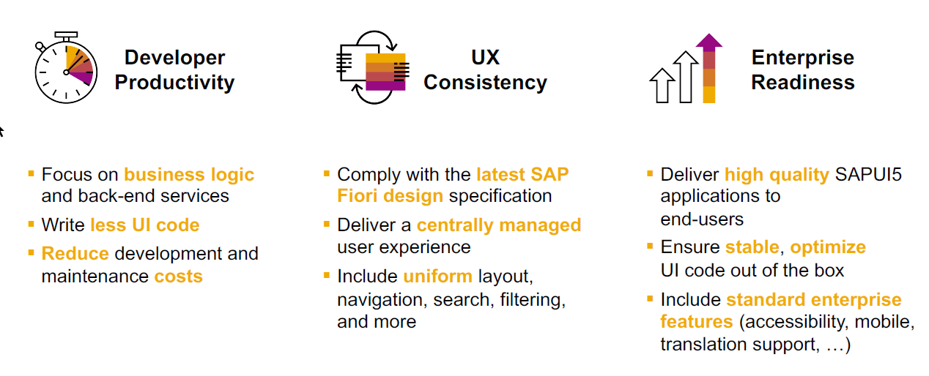
SAP Fiori elements boosts SAP Fiori development efficiency

Slide 9
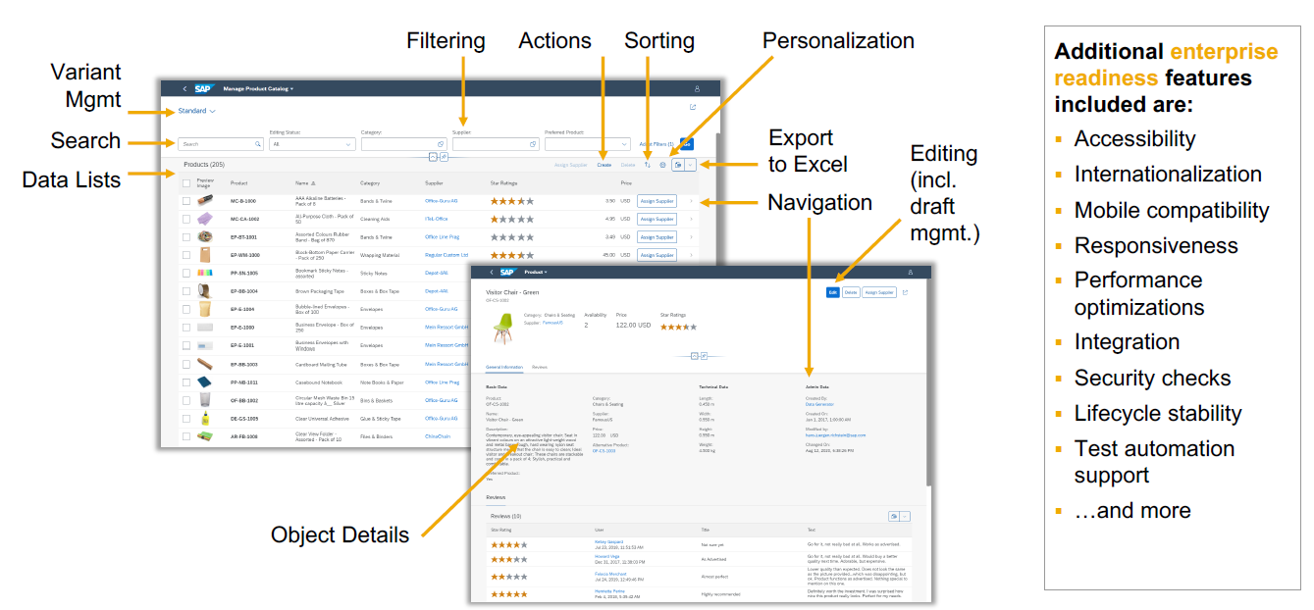
SAP Fiori elements provides enterprise-ready apps out of the box

Slide 10
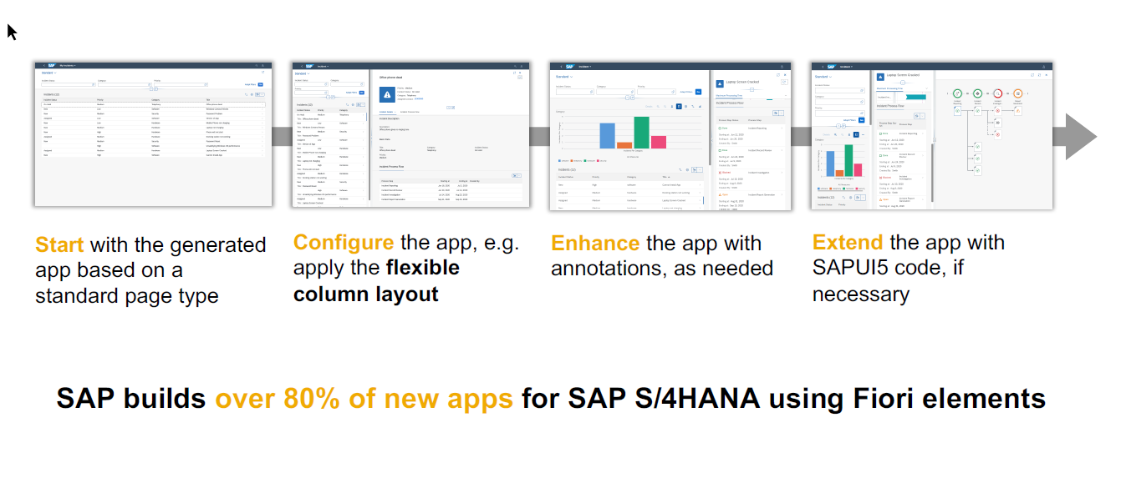
SAP Fiori elements application architecture provides flexibility

Slide 11
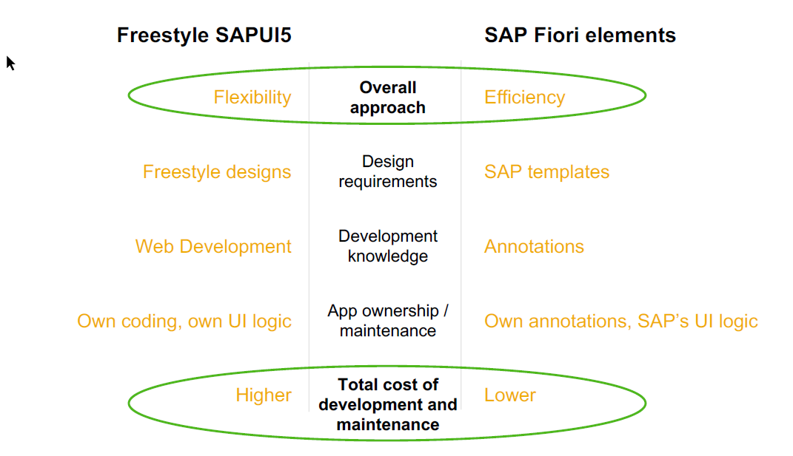
SAP Fiori elements prioritizes efficiency over flexibility

Slide 12
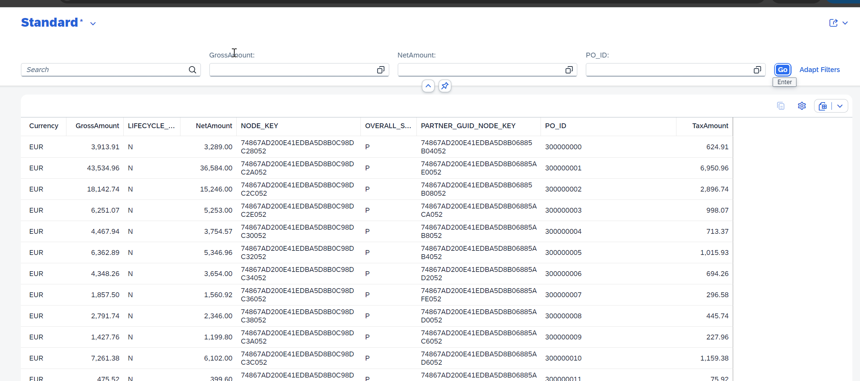
@UI.selectionField
@UI.LineItem

Slide 13
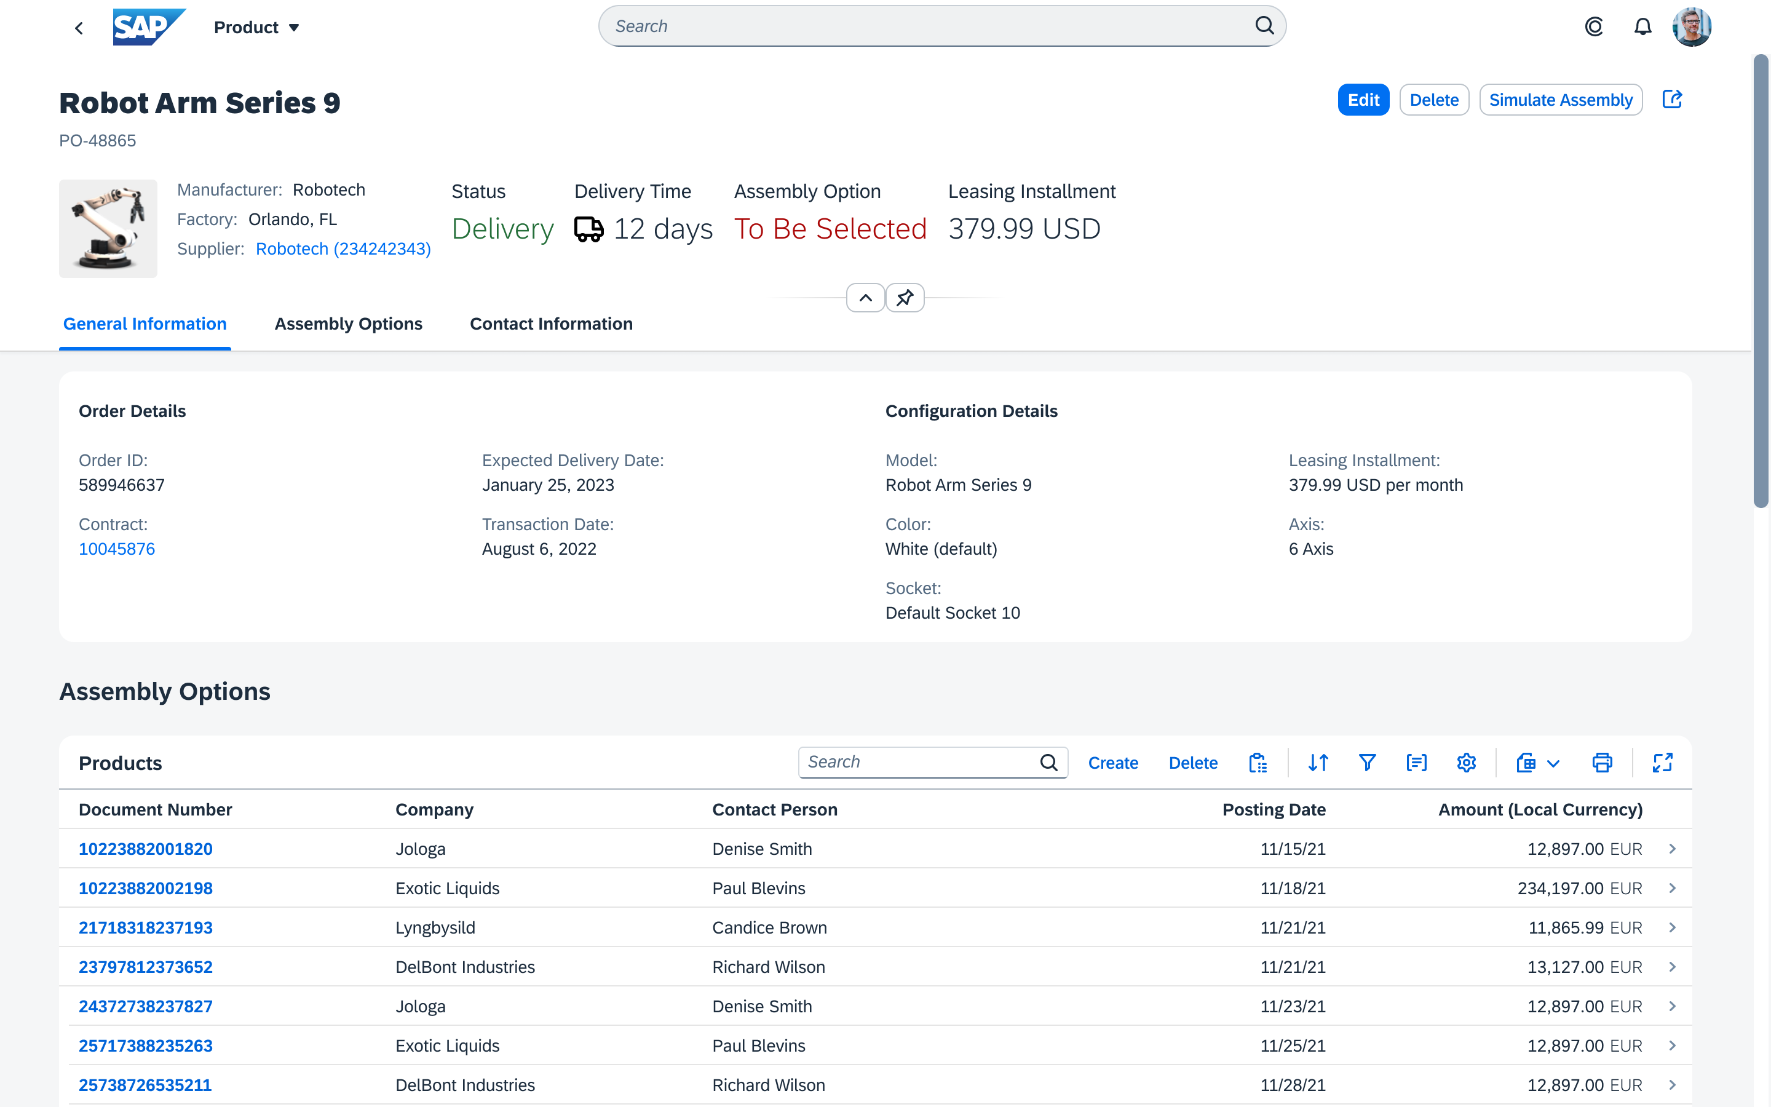
@UI.HeaderInfo
@UI.Facets
@UI.Identification
@UI.FieldGroup
@UI.Collection

Slide 14

Hands on : Fiori App

Slide 15
Create Fiori App using Annotation
Exercise:
https://github.com/soyuztechnologies/SAP_BTP_Training_CLD200/blob/master/Day%203/03%20application/03application/app/purchaseorderapp/annotations.cds

Slide 16
Association v.s Composition
Association – a relationship between entities which is a lose coupling. Both objects should exist together. However, they can work independently. Airplane and passenger.
Composition – a relationship between entities which is a tight coupling. Both objects must exist together. They cannot function independently. Airplane and wings.
Purchase Order Header
composition
Purchase order Items

Slide 17

Hands on: Create & F4 Enablement for app
Solution: https://github.com/soyuztechnologies/SAP_BTP_Training_CLD200/tree/master/Day%204/capm%20draft%20and%20value%20helps

Slide 19

What We Did
Let’s Summarize

Slide 20

www.anubhavtrainings.com
Thank You
End of Day 5

Slide 21


We’re committed to empower you to be
#FutureReady
through powerful training solutions.
We build the workforce of the future.
250+
Corporate Clients
50,000+
Learners Trained
25000+
Learners Placed
FREE WEBINARS
Sign up for free webinars with industry experts every fortnight!
Enroll Now!
Contact us today!
https://anubhavtrainings.com

Slide 22
Agenda – Day 5
01
04
Application Security
Identity Provider
02
05
MTA applications with module
Roles and Authorization management
03
06
CAP Application Security Testing
XSUAA Service

